Slide 1
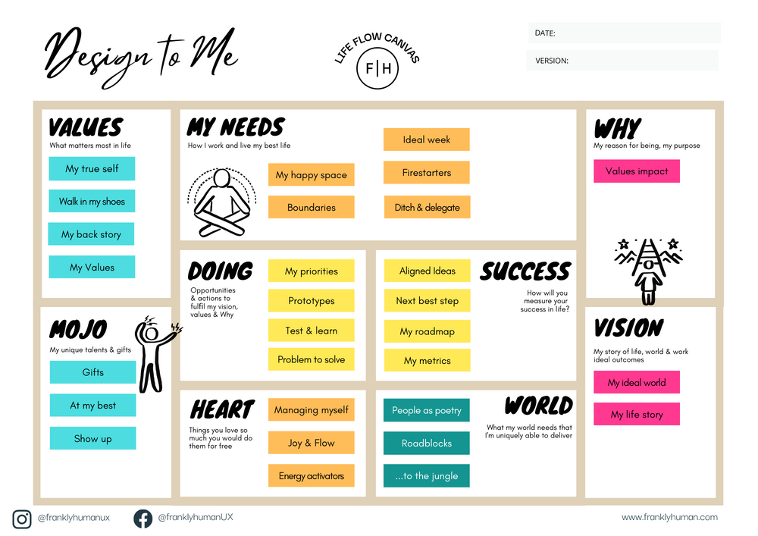
Welcome to an easy-to-implement blueprint to help you design your life that doesn’t ask you to shirk your responsibilities, run off to a silent meditation retreat or be so present you never work towards a goal again.

